Slide 1
Liquids

Slide 2
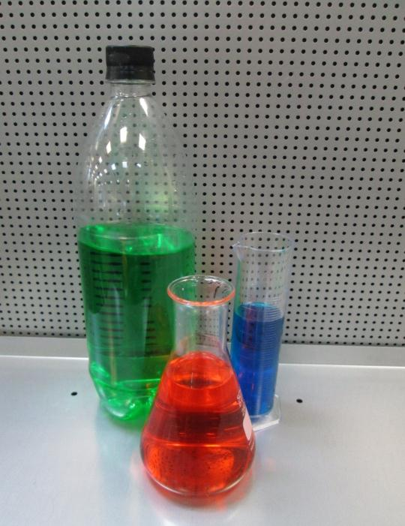
Liquids take the shape of the container they are in
Notes:
Liquids can be all sorts of different colours and thicknesses. Some you can see through, some you can’t. But all liquids take the shape of the container they are in; they don’t have a shape of their own.

Slide 3
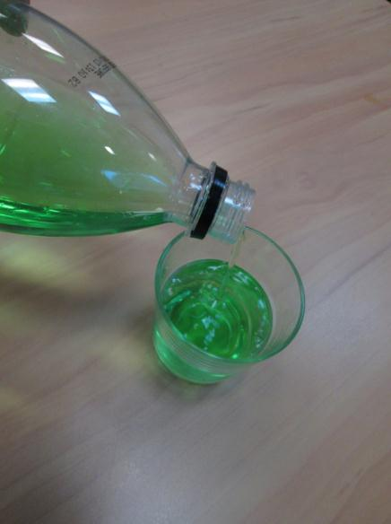
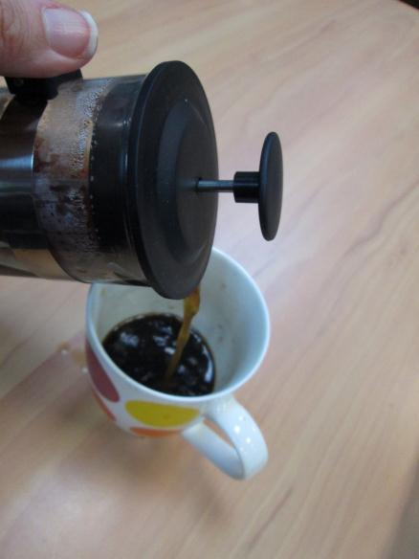
When a liquid is poured, it flows into the container
Notes:
When a liquid is poured, it flows and it is sometimes pulled into the bottom of the container.

Slide 4
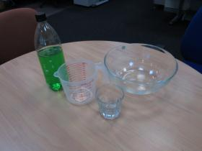
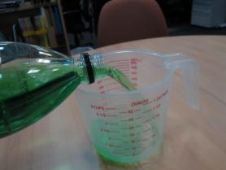
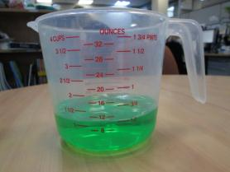
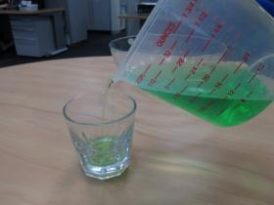
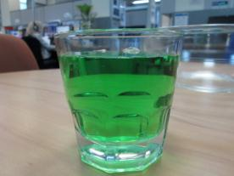
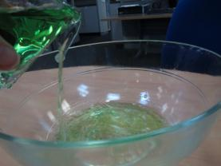
When liquid is poured, its shape changes to the shape of the container but the amount of the liquid doesn’t change.
Notes:
When a liquid is poured, its shape changes to the shape of the container but the amount of the liquid doesn’t change. In these photos you can see one cup of liquid being poured from a bottle into a jug, from the jug into a glass and then from the glass into the bowl. If the liquid was poured back into the jug (and if none of it had been spilled) how much liquid do you think there would be?

Slide 5
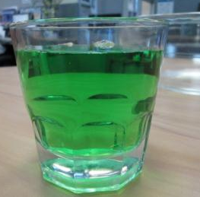
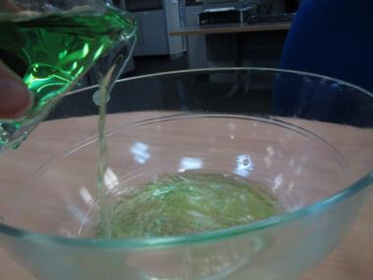
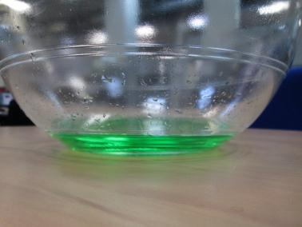
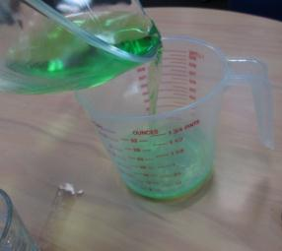

One cup of water poured into a bowl
And then poured from the bowl into a jug
Is still one cup of water
Notes:
Yes, you are right, there would be exactly the same amount of liquid. Even though the liquid in the glass has a tall and thin shape and when it is in the bowl it has as shorter, wider shape, it is still one cup of liquid in a jug, one cup of liquid in a glass, one cup of liquid in a bowl, then one cup of liquid in a glass again. The shape of the liquid changes with each container it gets poured into, but the volume never changes.

Slide 6
Liquids have
shape
No fixed
volume
A fixed
Notes:
Liquids have no fixed shape but they do have a fixed volume.

Slide 7
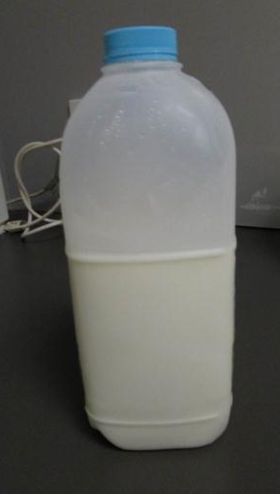
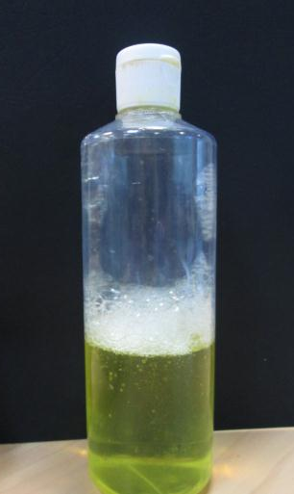
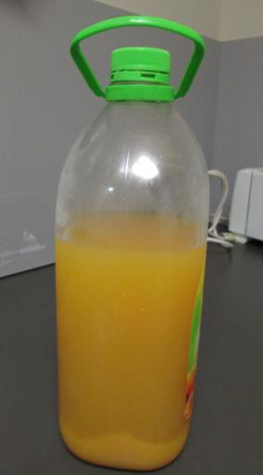
What liquids can you think of?
Notes:
What liquids do you have around your home?

